Slide 1
Immigrants and Use of Nonverbal in New Culture
Sheida Shirvani, Ph.D

Slide 2
Definition of Culture
Globalization makes culture no more bound to a geographical area, race or religion.
Culture the social behavior and norms found in human societies, as well as the knowledge, beliefs, arts, laws, customs, capabilities, and habits of the individuals in these groups.
We attain culture through the learning processes of enculturation and socialization, which is shown by the diversity of cultures across societies.
Source: en.wikipedia.org

Slide 3
Definition of Gender
Gender is the range of characteristics pertaining to and differentiating between femininity and masculinity. Depending on the context, this may include sex-based social structures and gender identity.
Gender describes the characteristics of women and men that are socially constructed.
Sex refers to those that are biologically determined. People are born female or male but learn to be girls and boys who grow into women and men.
The learned behavior makes up gender identity and determines gender roles.
Source: World Health Organization

Slide 4
Definition of Immigrants and Emigrant
Immigrant or emigrant both refer to a person leaving their origin country for another country. When they leave their origin country, they are emigrant and when they arrive at their destination, they are immigrants.

Slide 5
Refuge – Asylum Seeker -- Migrant
A refugee is a person who has been forced to flee their home country due to persecution because of their race, religion, nationality, political opinion or membership in a particular social group.
Asylum seeker: An asylum seeker is a person who has fled persecution in their home country and is seeking safe haven in a different country.
Migrant: A migrant is a person who chooses to move from their home for any variety of reasons, but not necessarily because of a direct threat of persecution or death.
Source: HIAS.org

Slide 6
Nonverbal Communication
Communication is process of sending and receiving messages. Human sharing knowledge, attitudes, and skills via communication. When we communicate with others we usually communicate with speech. However, anything that is nonverbal happens entirely without words or speech.
Different types of nonverbal communication.
Source: https://www.creducation.net/resources/nonverbal_communication/

Slide 7
Nonverbal & Culture
Eastern Culture Examples:
Eastern Culture Examples:
Asian
Middle Eastern
Western Culture Examples
European
American

Slide 8
Types of Nonverbals
Eye contact
Touch. = Haptics
Space = Proxemics
Facial Expression
Postures.
Voice. =. Paralanguage
Body Movement. = Kinesics
Time =. Chronemics
Environment
Artifacts
Territoriality
Appearance

Slide 9
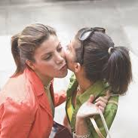
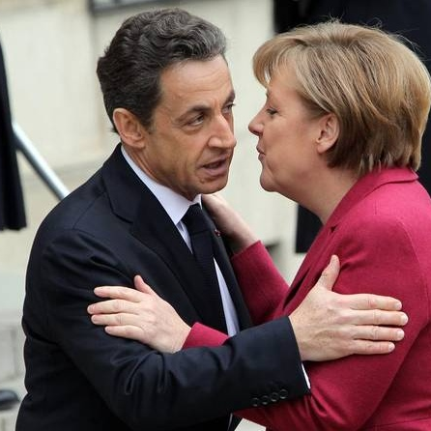
Different Nonverbal Greeting Style

Slide 10
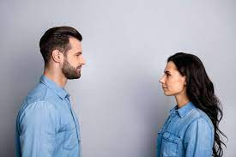
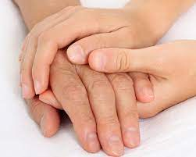
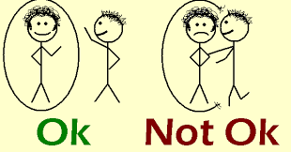
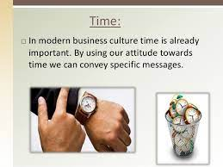
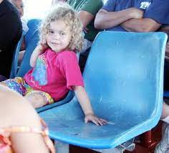
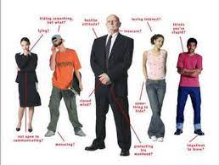
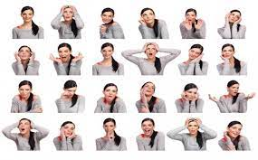
Samples Of Nonverbal and Cultures

